Slide 1
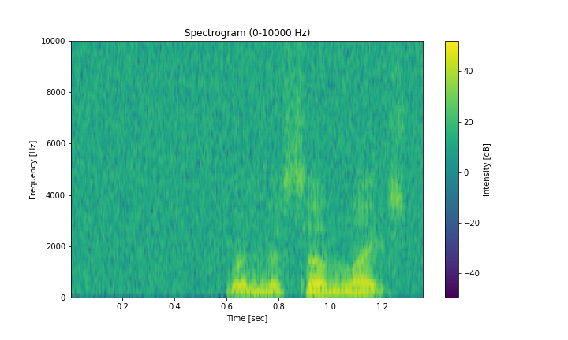
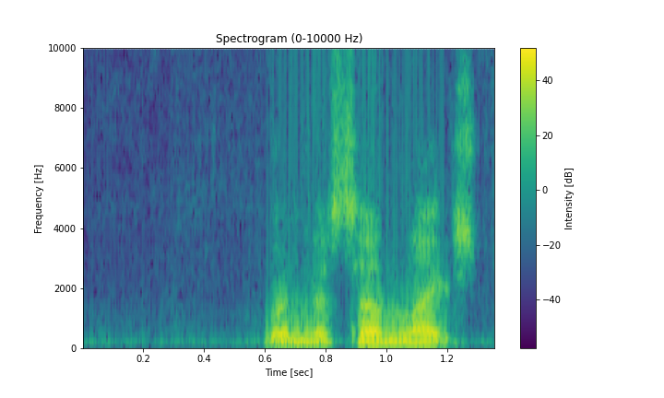
Reduction
Reduction
local attention
Conv 3x3
x₁
Codebook
Conv 3x3
e₁₁,...,e_{N1}
x₂
S
e₁₂,...,e_{N2}
Expansion
...
x₁
...
e₁₁,...,e_{N1}
FC
Expansion
x_{k}
x₂
S
e₁₂,...,e_{N2}
FC
Conv 3x3
Key
...
e_{1K},...,e_{NK}
...
Conv 3x3
x_{k}
Value
e_{1K},...,e_{NK}
Feature
Interaction
BN-ReLU
Key
Value
BN-ReLU
BN-ReLU
Conv5×5
Conv5×5
BN-ReLU
GroupNorm
GroupNorm
GroupNorm
GroupNorm
Depthwise
Convolution
Channel
MLP
Depthwise
Convolution
Channel
MLP
Channel
Scaling
Channel
Scaling
Channel
Scaling
Feature Interaction
Channel
Scaling
GroupNorm
Reduction
=
Reduction
BatchNorm
GroupNorm
GroupNorm
BN-ReLU
Reduction
GroupNorm
Depthwise
Convolution
Conv5×5
Conv 3x3
Relu
Channel
MLP
Depthwise
Convolution
Conv5×5
Conv 3x3
Conv 3x3
Channel
MLP
Channel
Scaling
BN-ReLU
Expansion
Mean
Channel
Scaling
Channel
Scaling
Expansion
Expansion
Channel
Scaling
Conv 3x3
FC
Conv 3x3
FC
BN-ReLU
BN-ReLU
Input X
x₁
local attention
e₁₁,...,e_{N1}
Feature
Interaction
Feature Interaction
x₂
S
e₁₂,...,e_{N2}
...
...
x_{k}
e_{1K},...,e_{NK}
Key
Value
Avg
Broadcasting
Element-wise Addition
Conv1×1
Conv5×5
Context Broadcasting(CB)
Concat
Complex
GlobalScope MLP
Global Scope
Dependencies Interaction
BN-ReLU
Local Scope Interaction
Complex
Local Attention
Real Domain Feature Extraction
Imaginary Domain Feature Extraction
Scaling Factors
Context Boradcasting
Channel-wise Multiplication
Channel-wise Addition

